Slide 1
Cybersecurity
Dumpster Diving

Slide 2

Dumpster Diving
Important information thrown out with the trash
Recycling bins are nice and clean too!
Gather information for a different attack
Impersonate names
Use common phone numbers
Find vendors items purchased from
Timing is important
Documents thrown out just after the end of the month, end of quarter, same day of the week
Get it before scheduled pickup

Slide 3

Is it Legal to Dive in a Dumpster?
In the United States, it is legal
Check local laws though
If it’s in the trash, it’s free
Technically nobody owns it any longer
Dumpsters on private property or marked “No Trespassing”
It might be trash, but that’s still trespassing
It’s tricky. Consult a legal professional

Slide 4
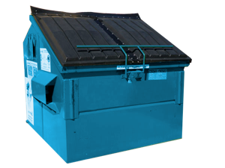
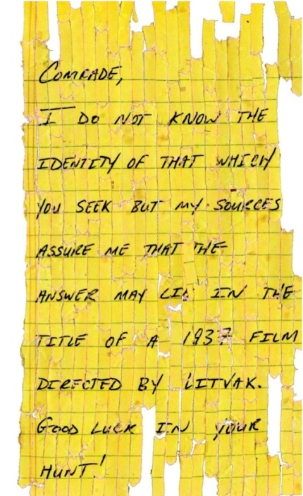
Protect your Trash
Secure the dumper
Fence and lock
No trespassing
Shred
Determined attackers can reassemble shreds
Governments burn sensitive documents
Audit your trash
Dig around, what can you find?

